Slide 1


Congratulations, YOU Win This Level
Press N to level up, R to start again from level 1 or q to quit the game.

Slide 2
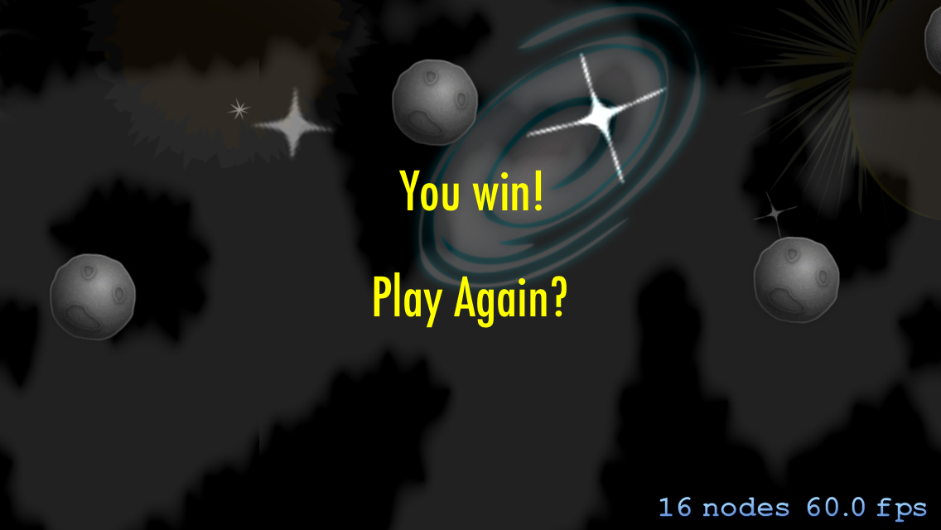

Slide 3

Congratulations, You beat the game!!! Press R to start again from level 1 or q to end the game

Slide 4


Slide 5

Press R to start again from level 1 or q to quit the game.

Slide 6
WELCOME TO the craft of mining. Click on the screen to continue

Slide 7


Mine for diamonds, avoid the hidden fires. use the up, down and side arrows to move. pass level 10 and beat the game.
CLICK ON THE SCREEN TO CONTINUE.

